Slide 1
ISEM -501- Project 3
RICheeze Console
Aman Tatipally- 147651

Slide 2
Project Description
RICheeze console helps to import Menu Items , Categories, Deals and have a track of the users using there RICheeze application.
Console has total 5 screens
Dashboard Screen
Menu Screen
Deals Screen
Customers Screen
Drivers Screen

Slide 3
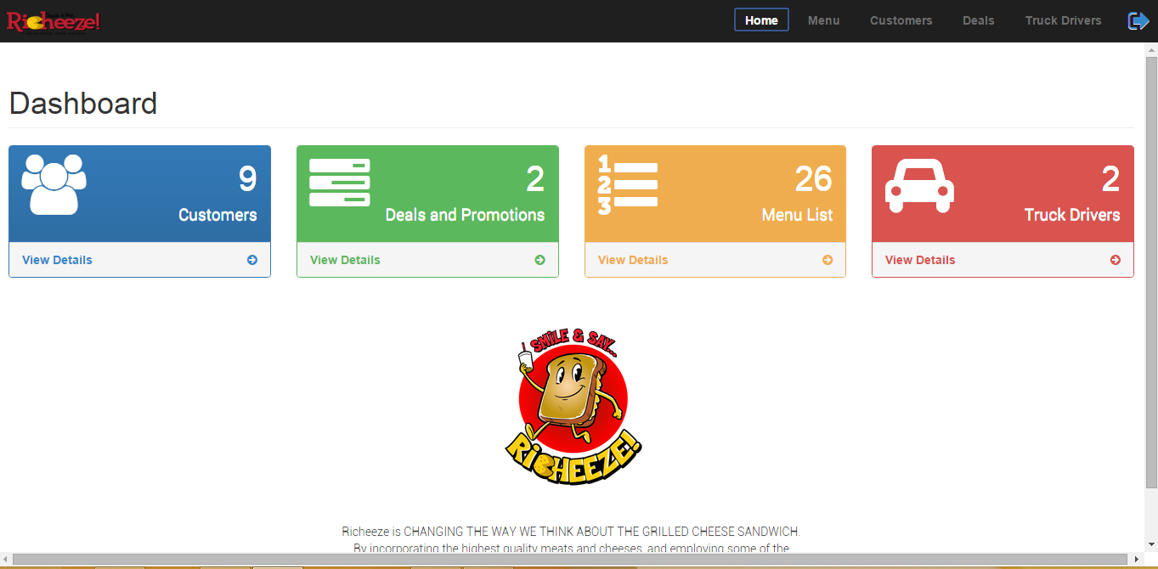
Dashboard Screen
This screen is useful to keep track of all the five screens.

Slide 4
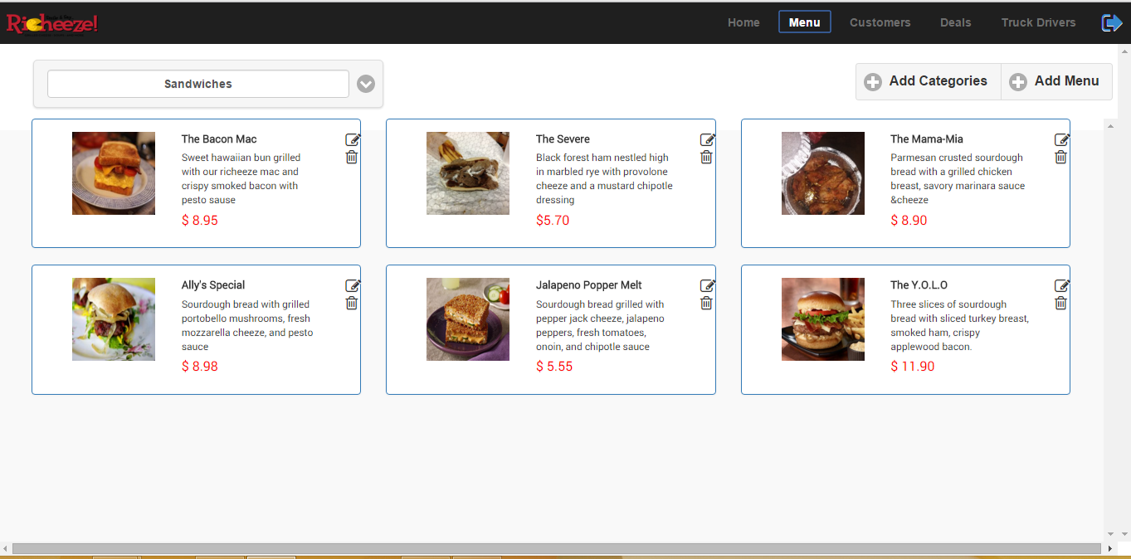
Menu Screen

Slide 5
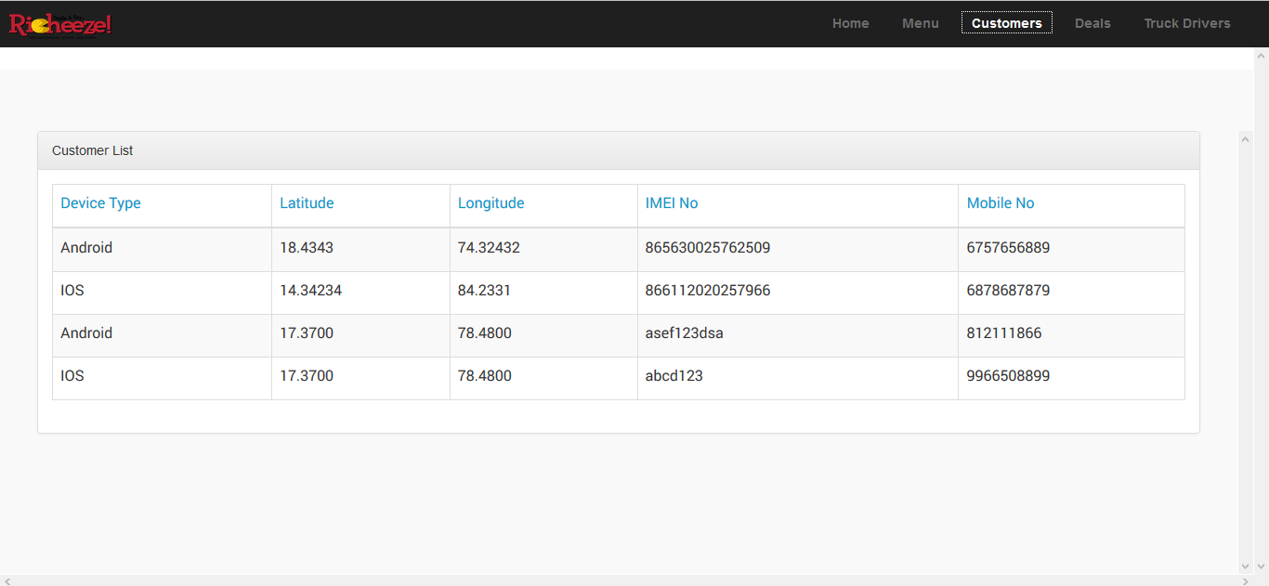
Customers Screen

Slide 6
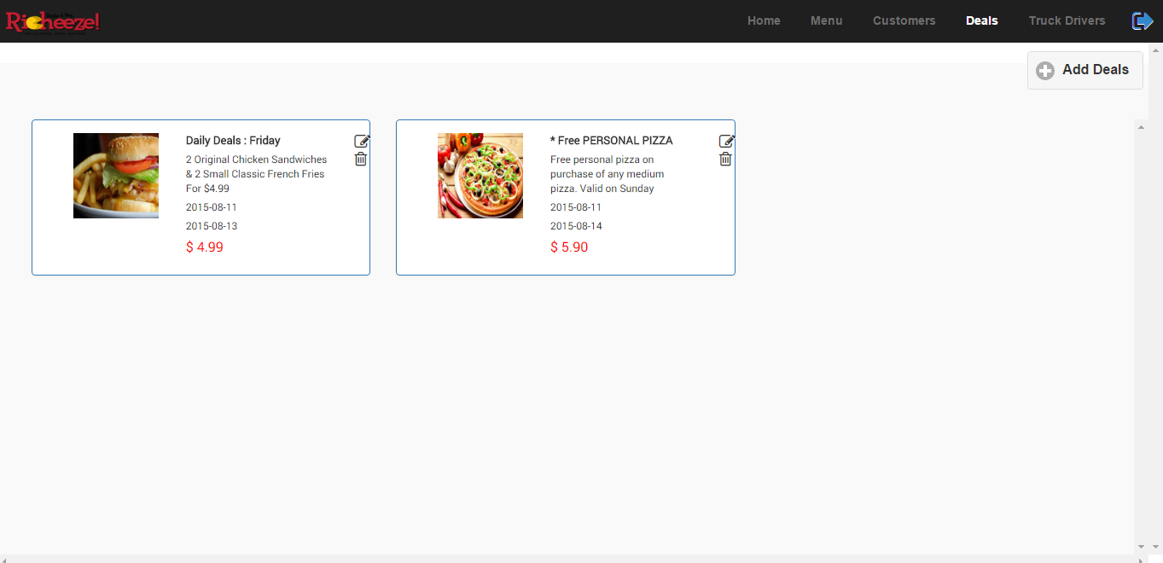
Deals Screen

Slide 7
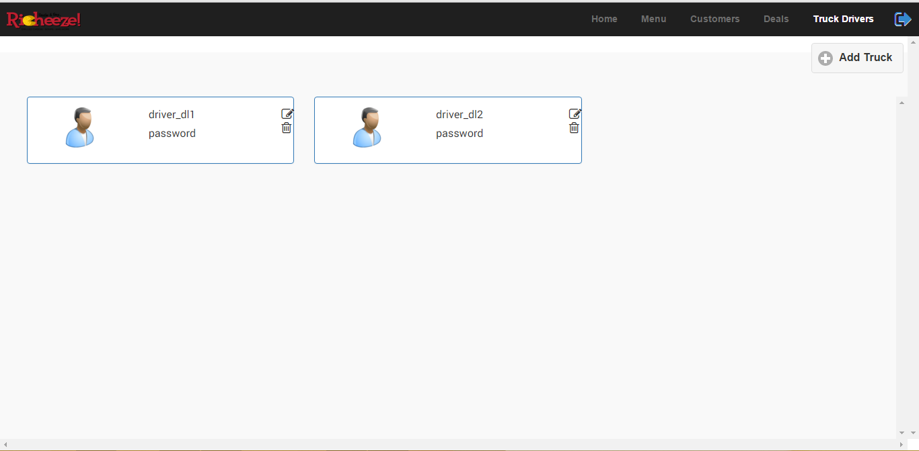
Truck Drivers Screen

Slide 8
THANKS

